Slide 1
GitHub going in and going out Desktop

Slide 2

Click on the Cat

Slide 3
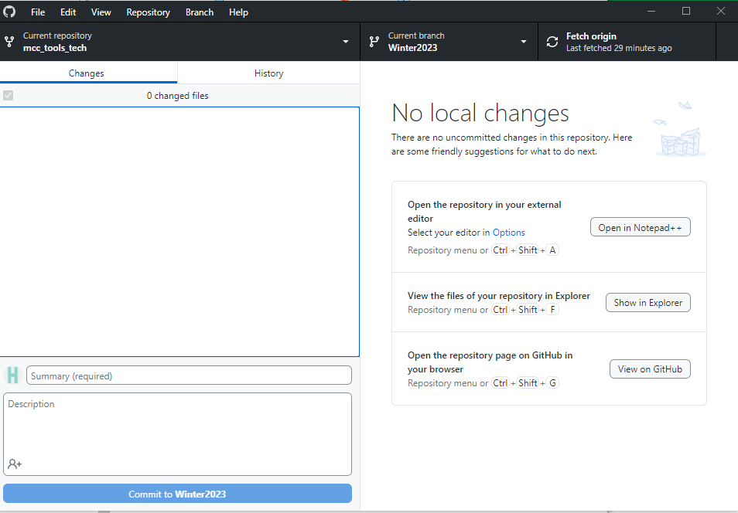
Fetch the latest file

Slide 4
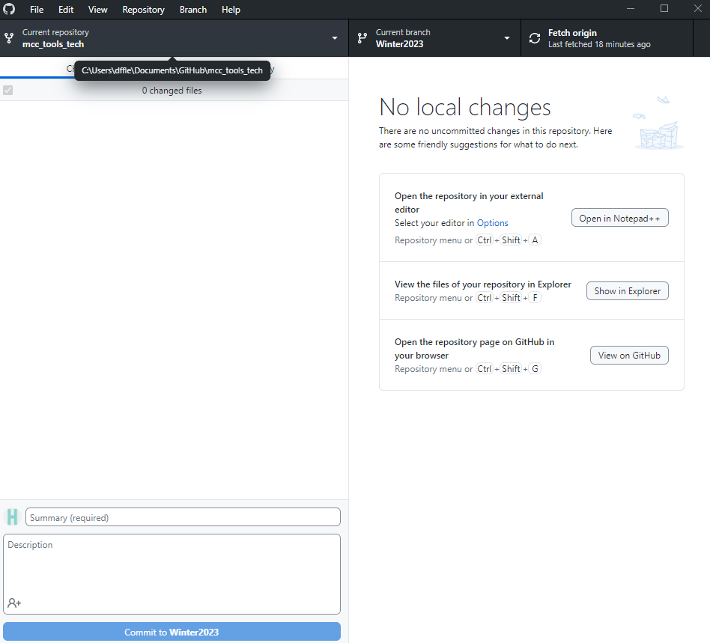
Working options

Slide 5
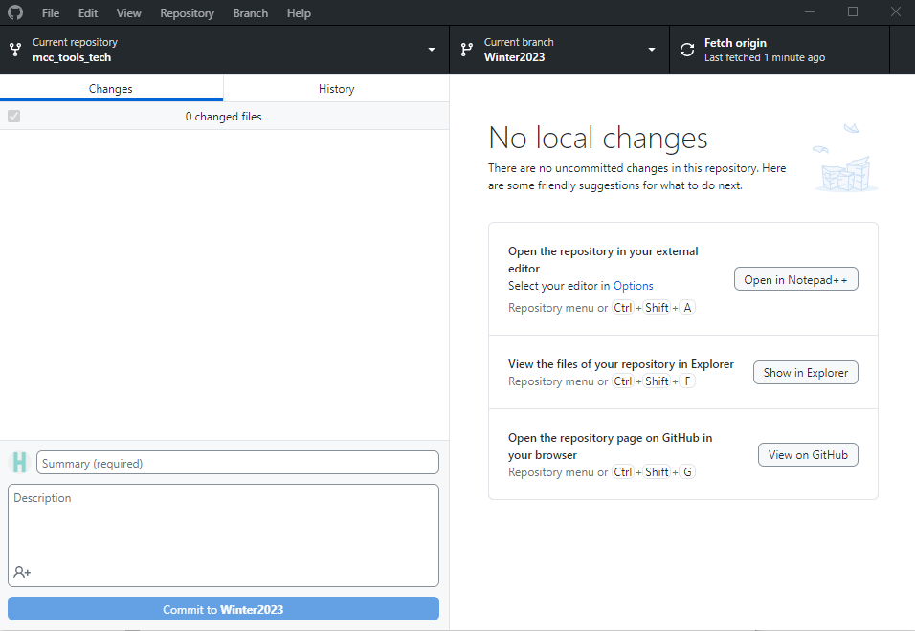
Other options

Slide 6
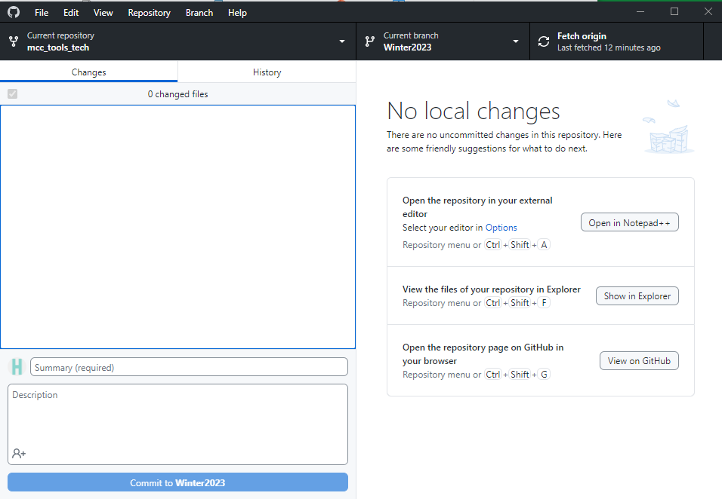
A brief summary
of your work

Slide 7
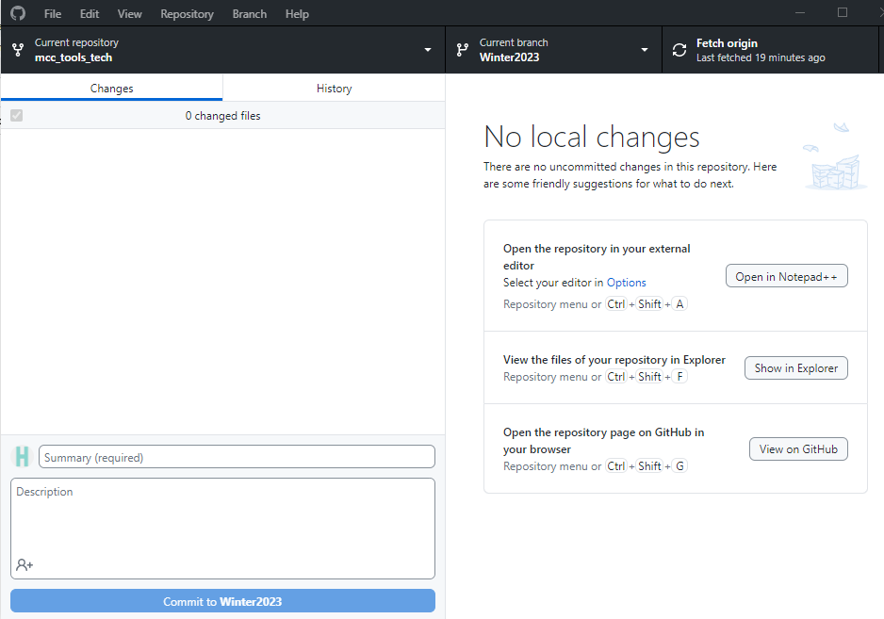
Provide some details

Slide 8

MUST
Commit

Slide 9
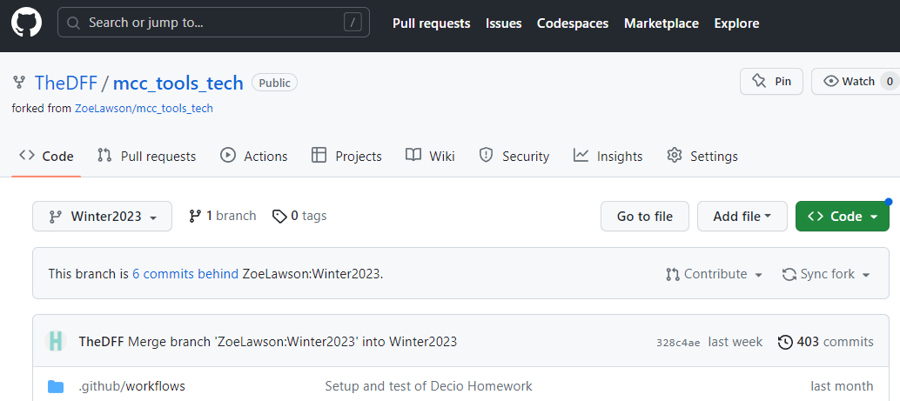
ABSOLUTELY!!!
MUST
Synk

Slide 10
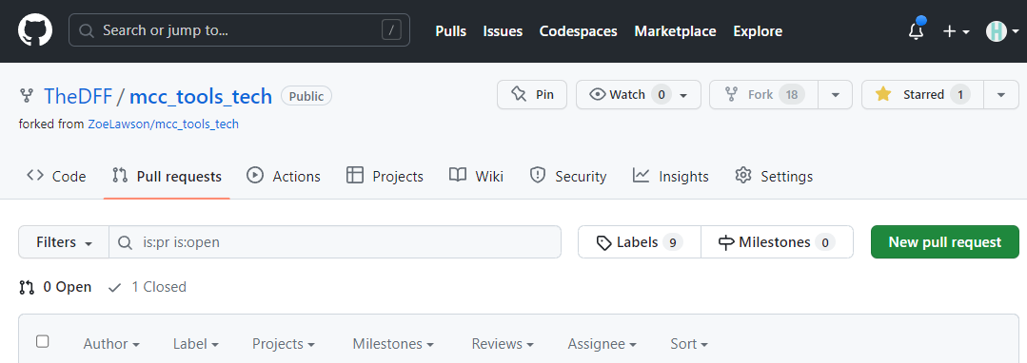
Activate
“Pull Request”

Slide 11
Make the
“Pull Request”

Slide 12
Congratulations
You have concluded
your side of the task

